Slide 1
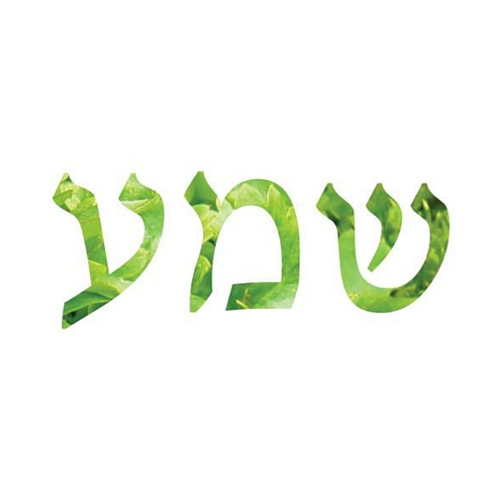
Project Shema
Shema: [command] “Hear”
To actively listen, understand, internernalize, and really comprehend.

Slide 2
Exploring English Tanakh
All English texts from Sefaria.org

Slide 3
Pipeline
English Version 1
W2V
English Version 1
Vector Embeddings
Concatenate all Vector Embeddings
in 2D
English Version 2
W2V
English Version 2
Vector Embeddings
PCA
...
...
English Version N
W2V
English Version N
Vector Embeddings
W2V
= skip-gram w/ negative word sampling
PCA
= reduced dims from 128 to 2

Slide 4
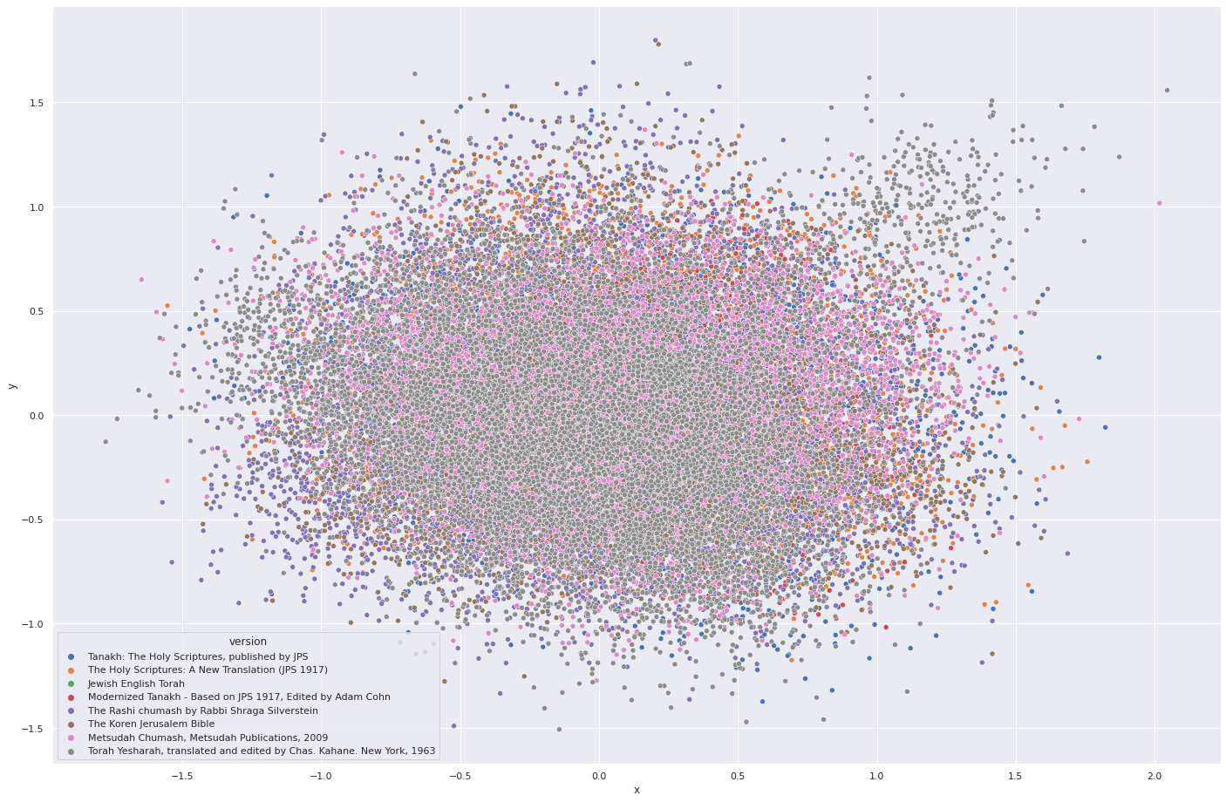

Slide 5
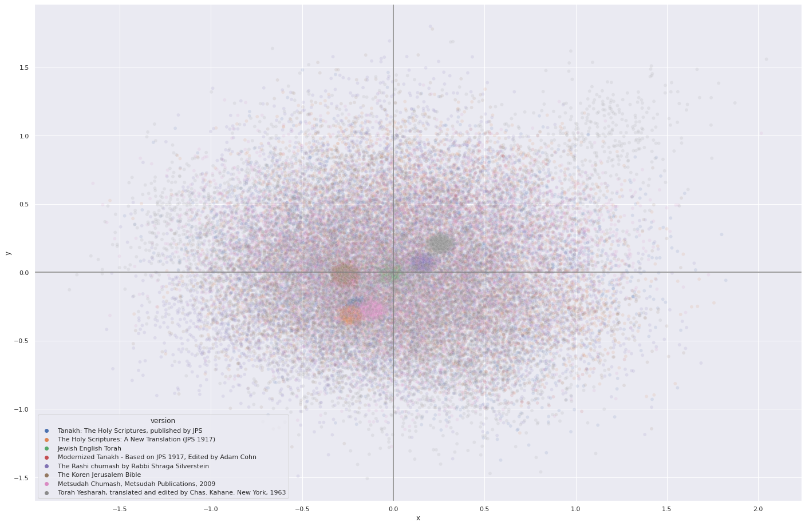

Slide 6
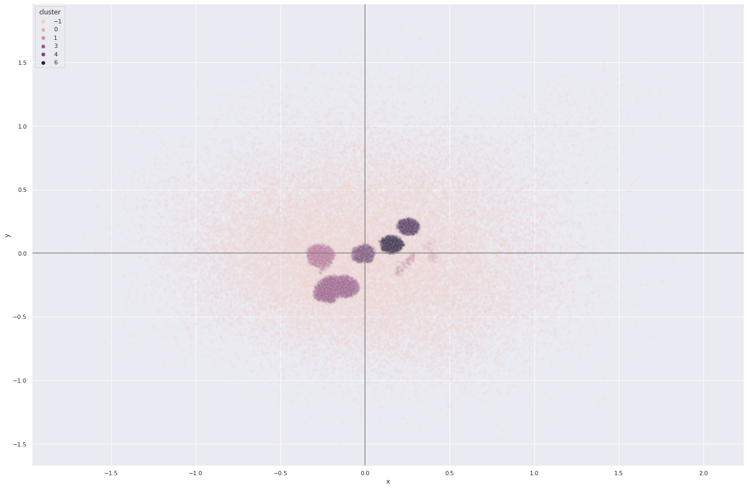
(HDBSCAN Clustering)

Slide 7
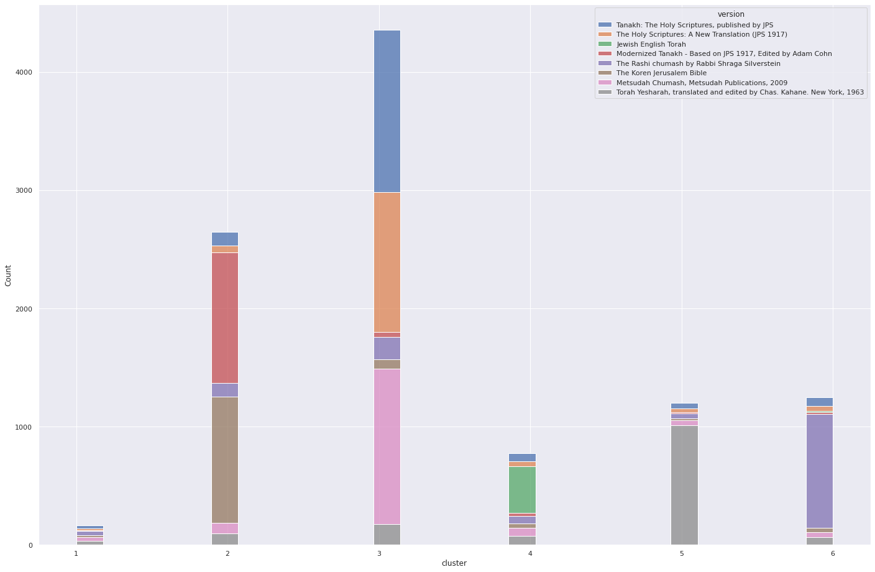

Slide 8
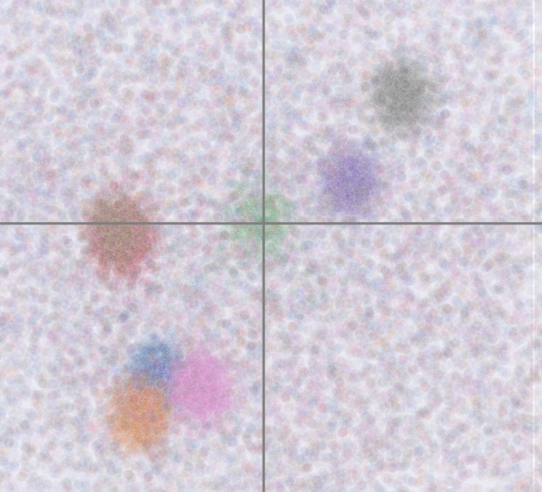
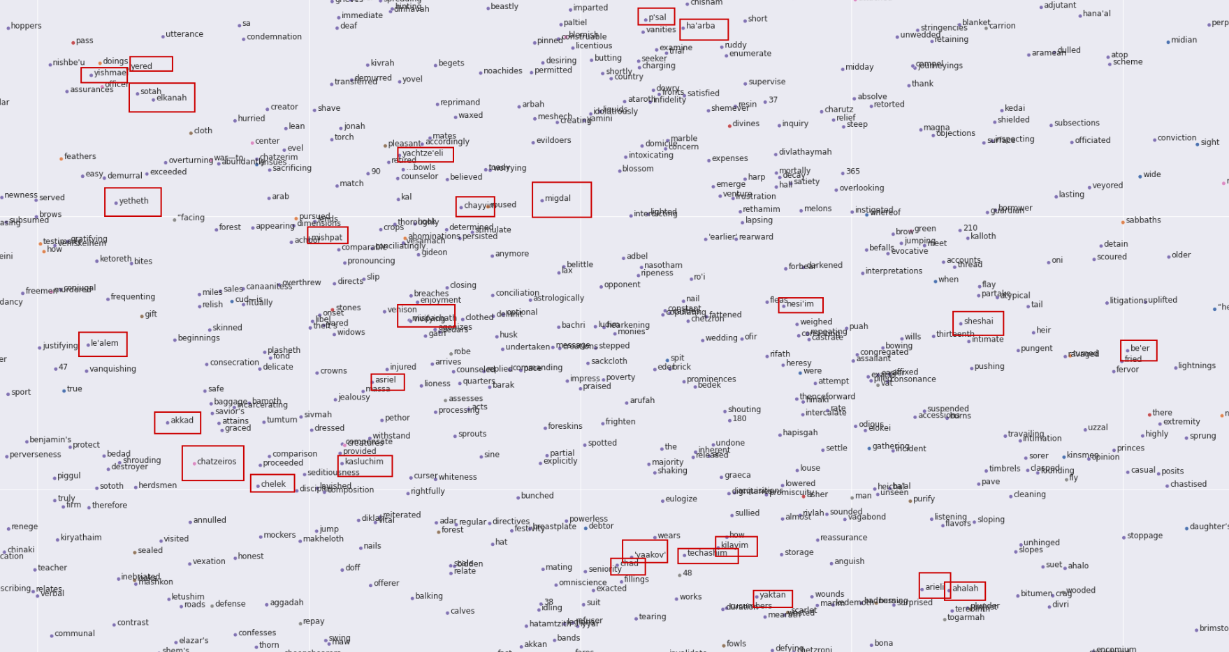
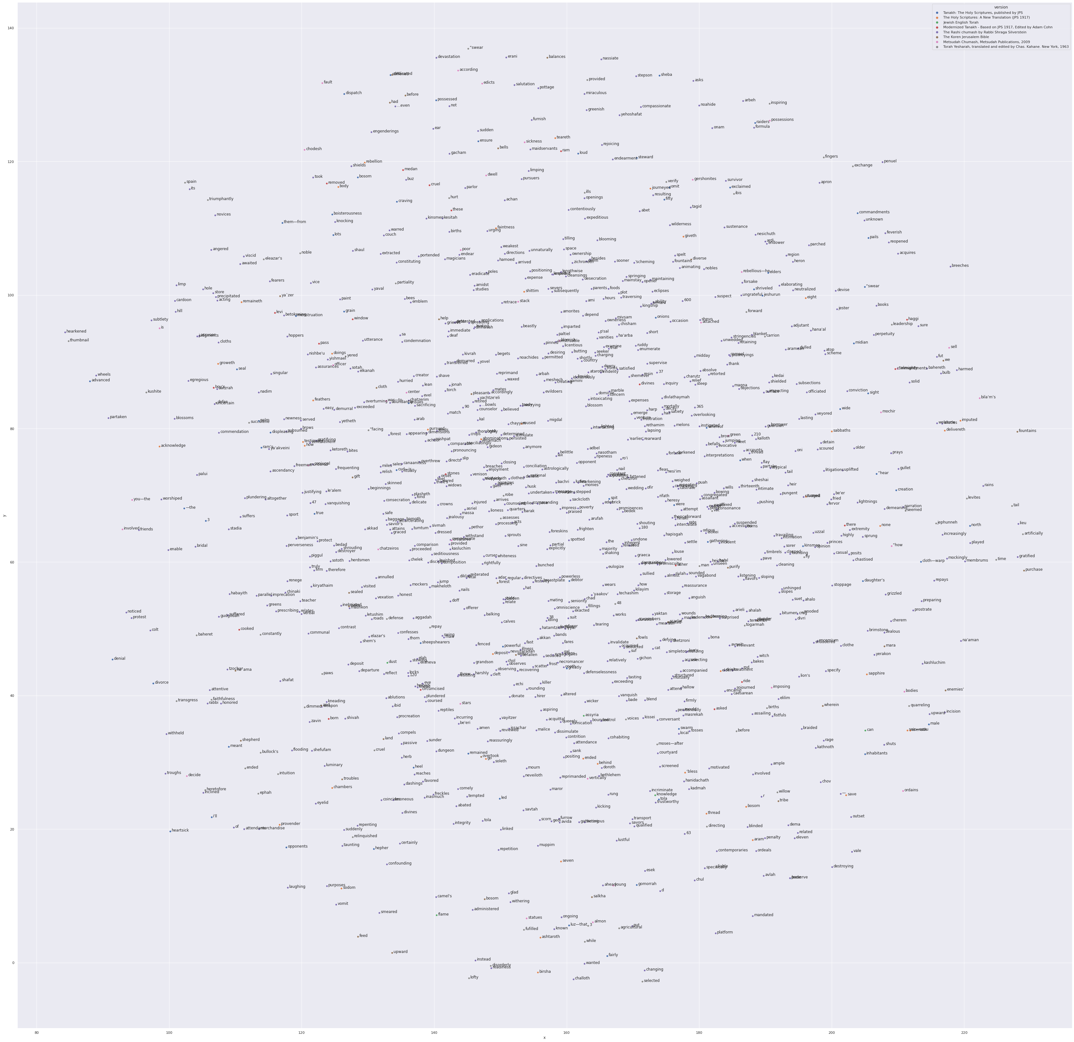
yered
yishmael
sotah
elkanah
yetheth
le'alem
akkad
chazeiros
chelek
mishpat
asriel
kasluchim
migdal
chayyi
p'sal

Slide 9
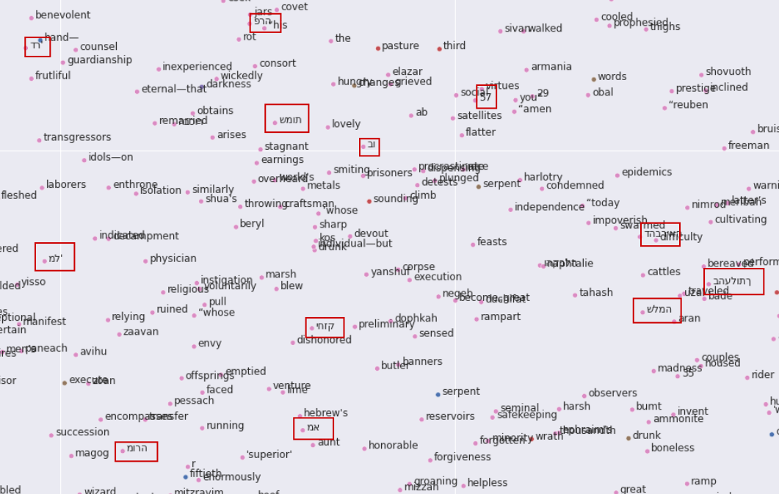
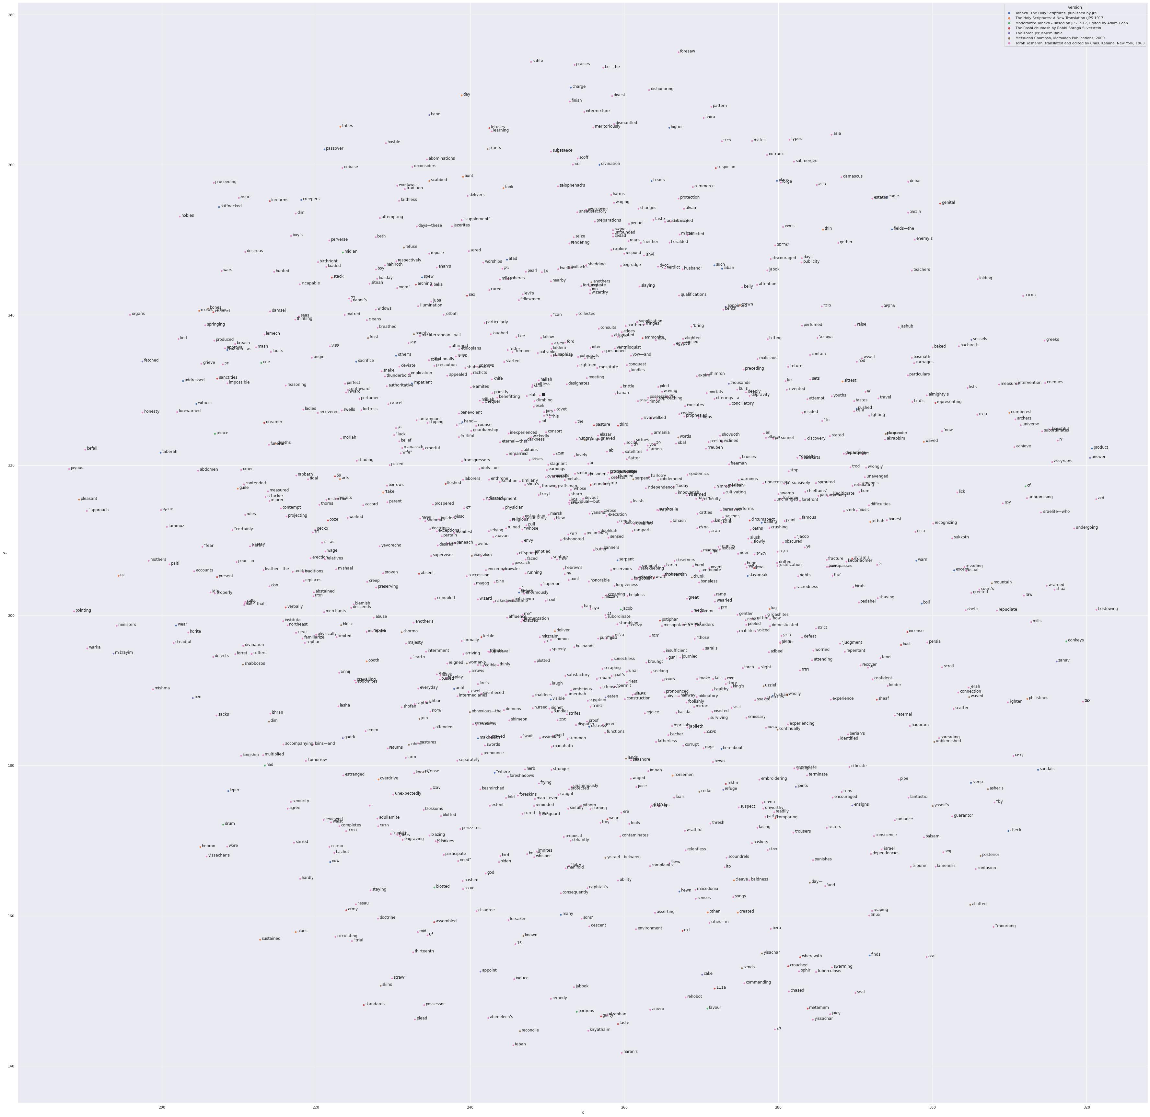

Slide 10
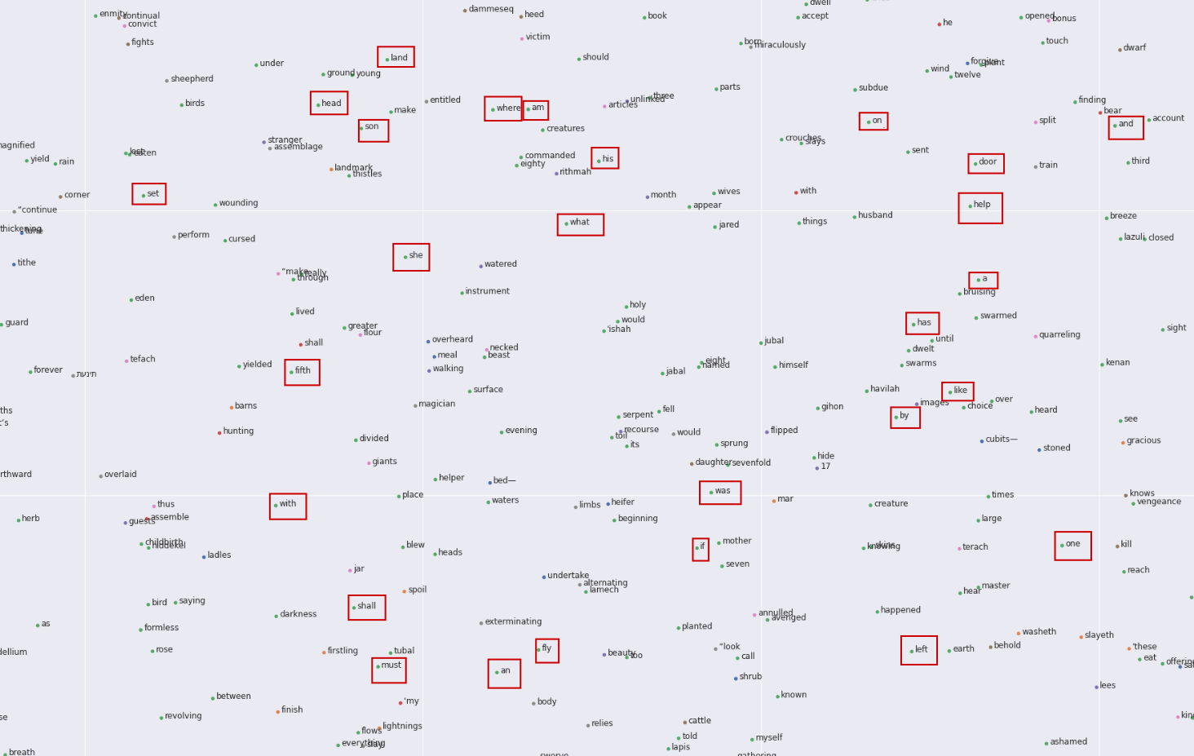

a
she
son
set
what
was
if
fly
an
has
like
by
on
fly
his
am

Slide 11
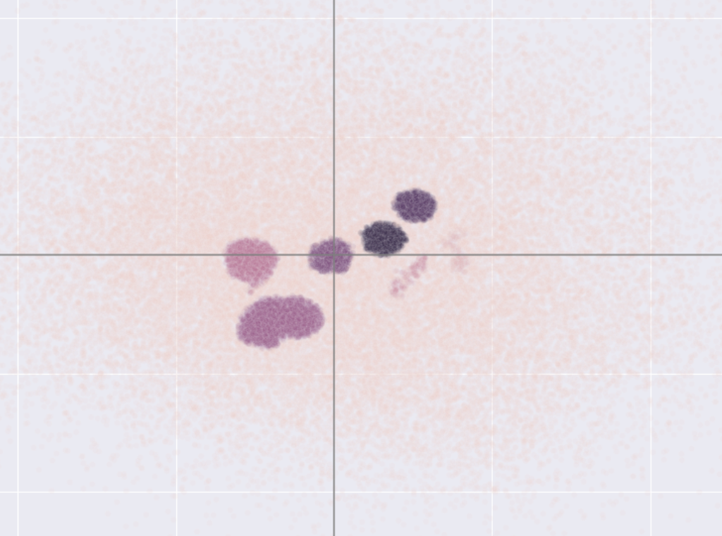
Very Basic English
Less modern English,
much transliterations
Most modern translation;
most direct translation;
no transliteration
Modern-ish english;
contains much transliterations
Most popular translations

Slide 12
Exploring Hebrew & English

Slide 13
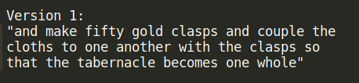
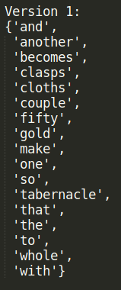
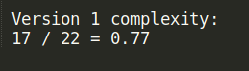
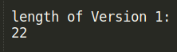
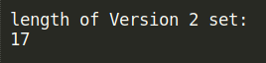

Slide 14
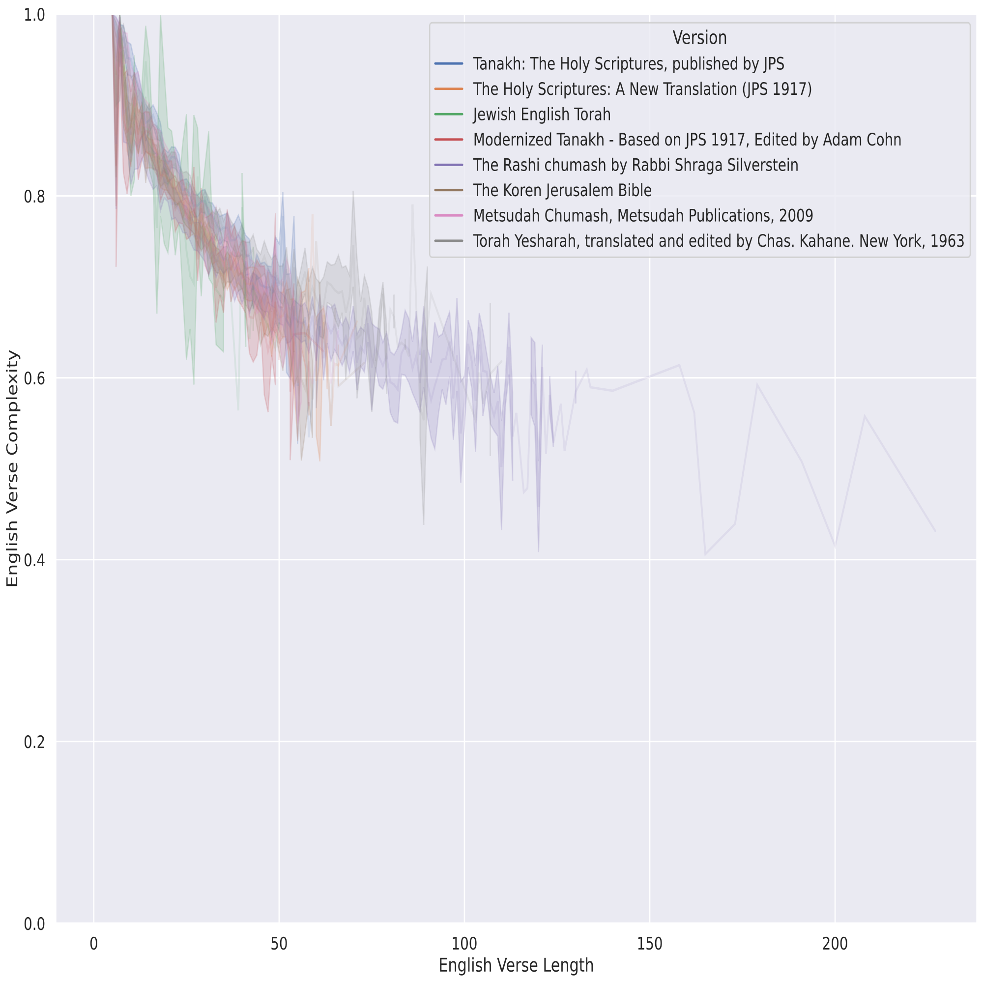
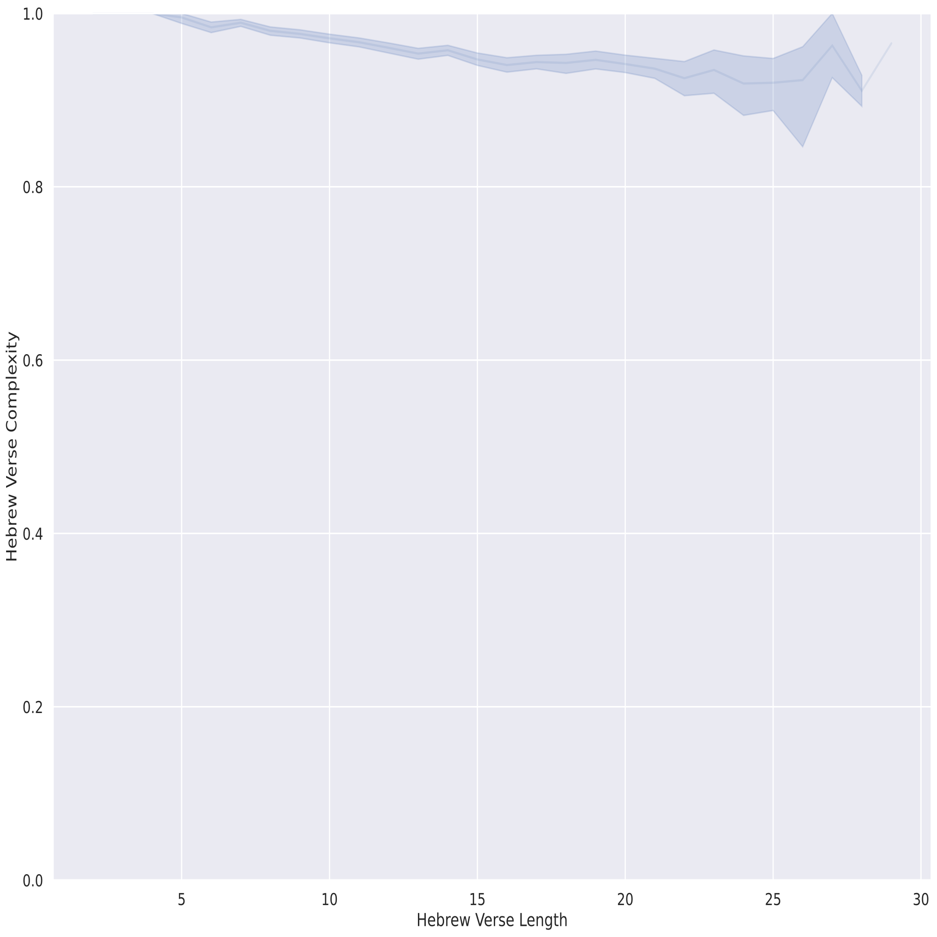

Slide 15
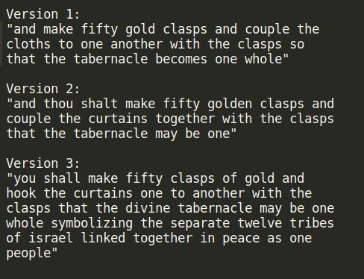
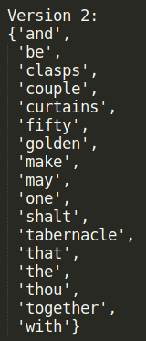
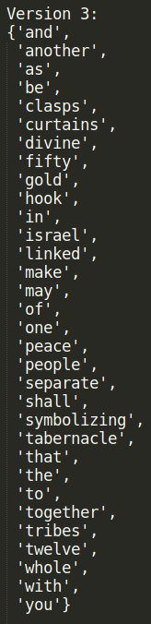
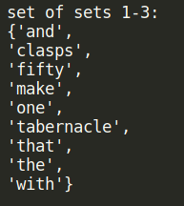
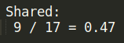

Slide 16
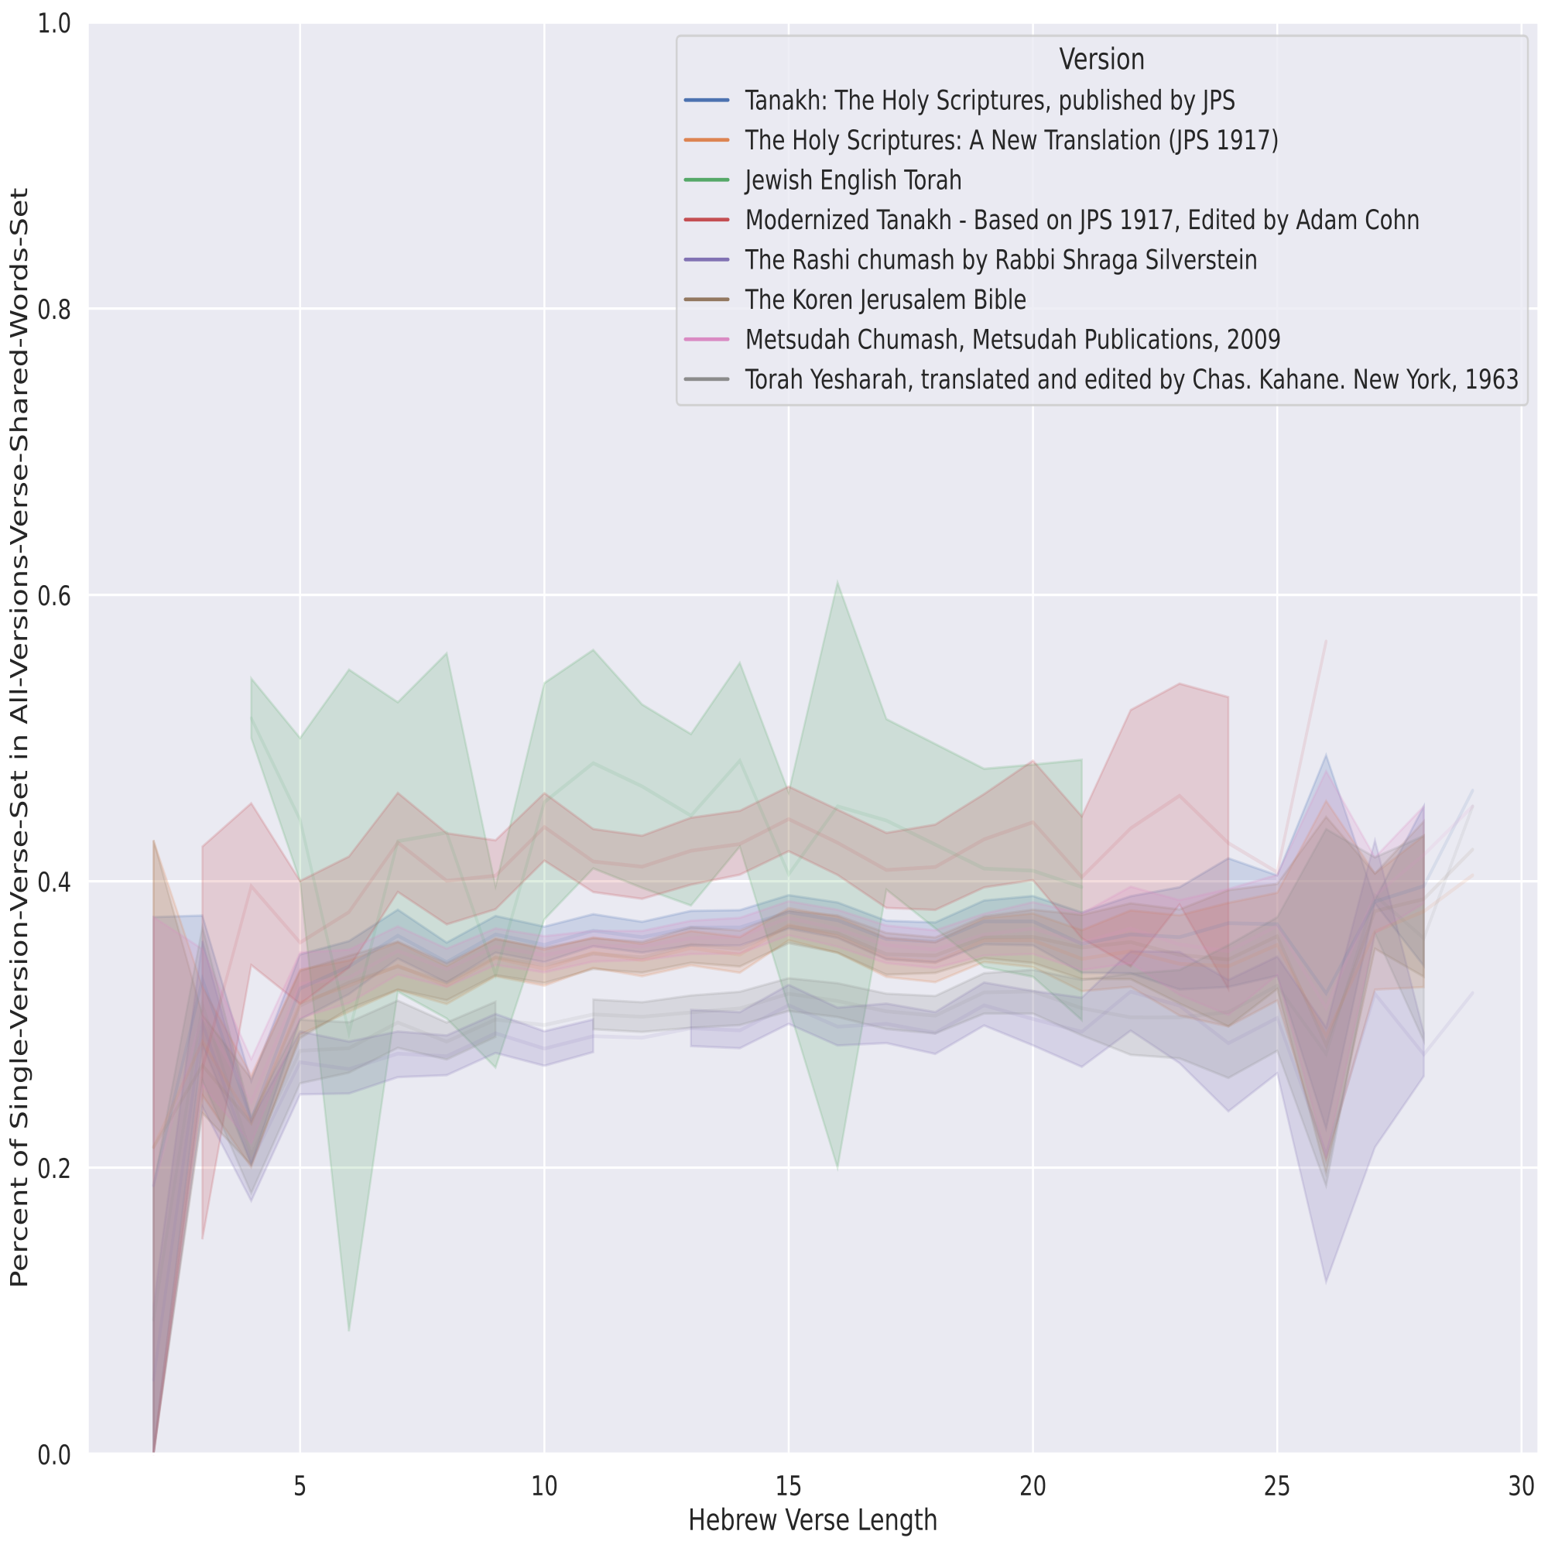

Slide 17
Model Building

Slide 18
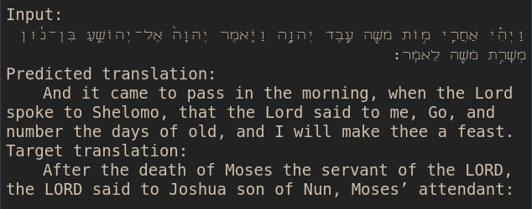
First Model = BAD

Slide 19
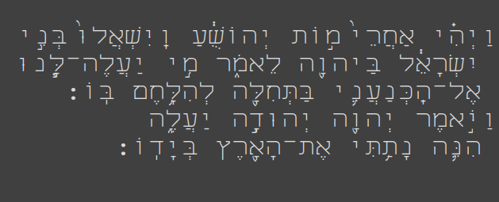
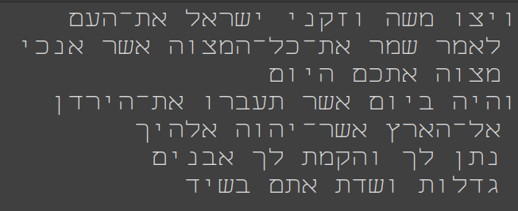
Switched

Slide 20
Translation Model
Transformer Model

Slide 21
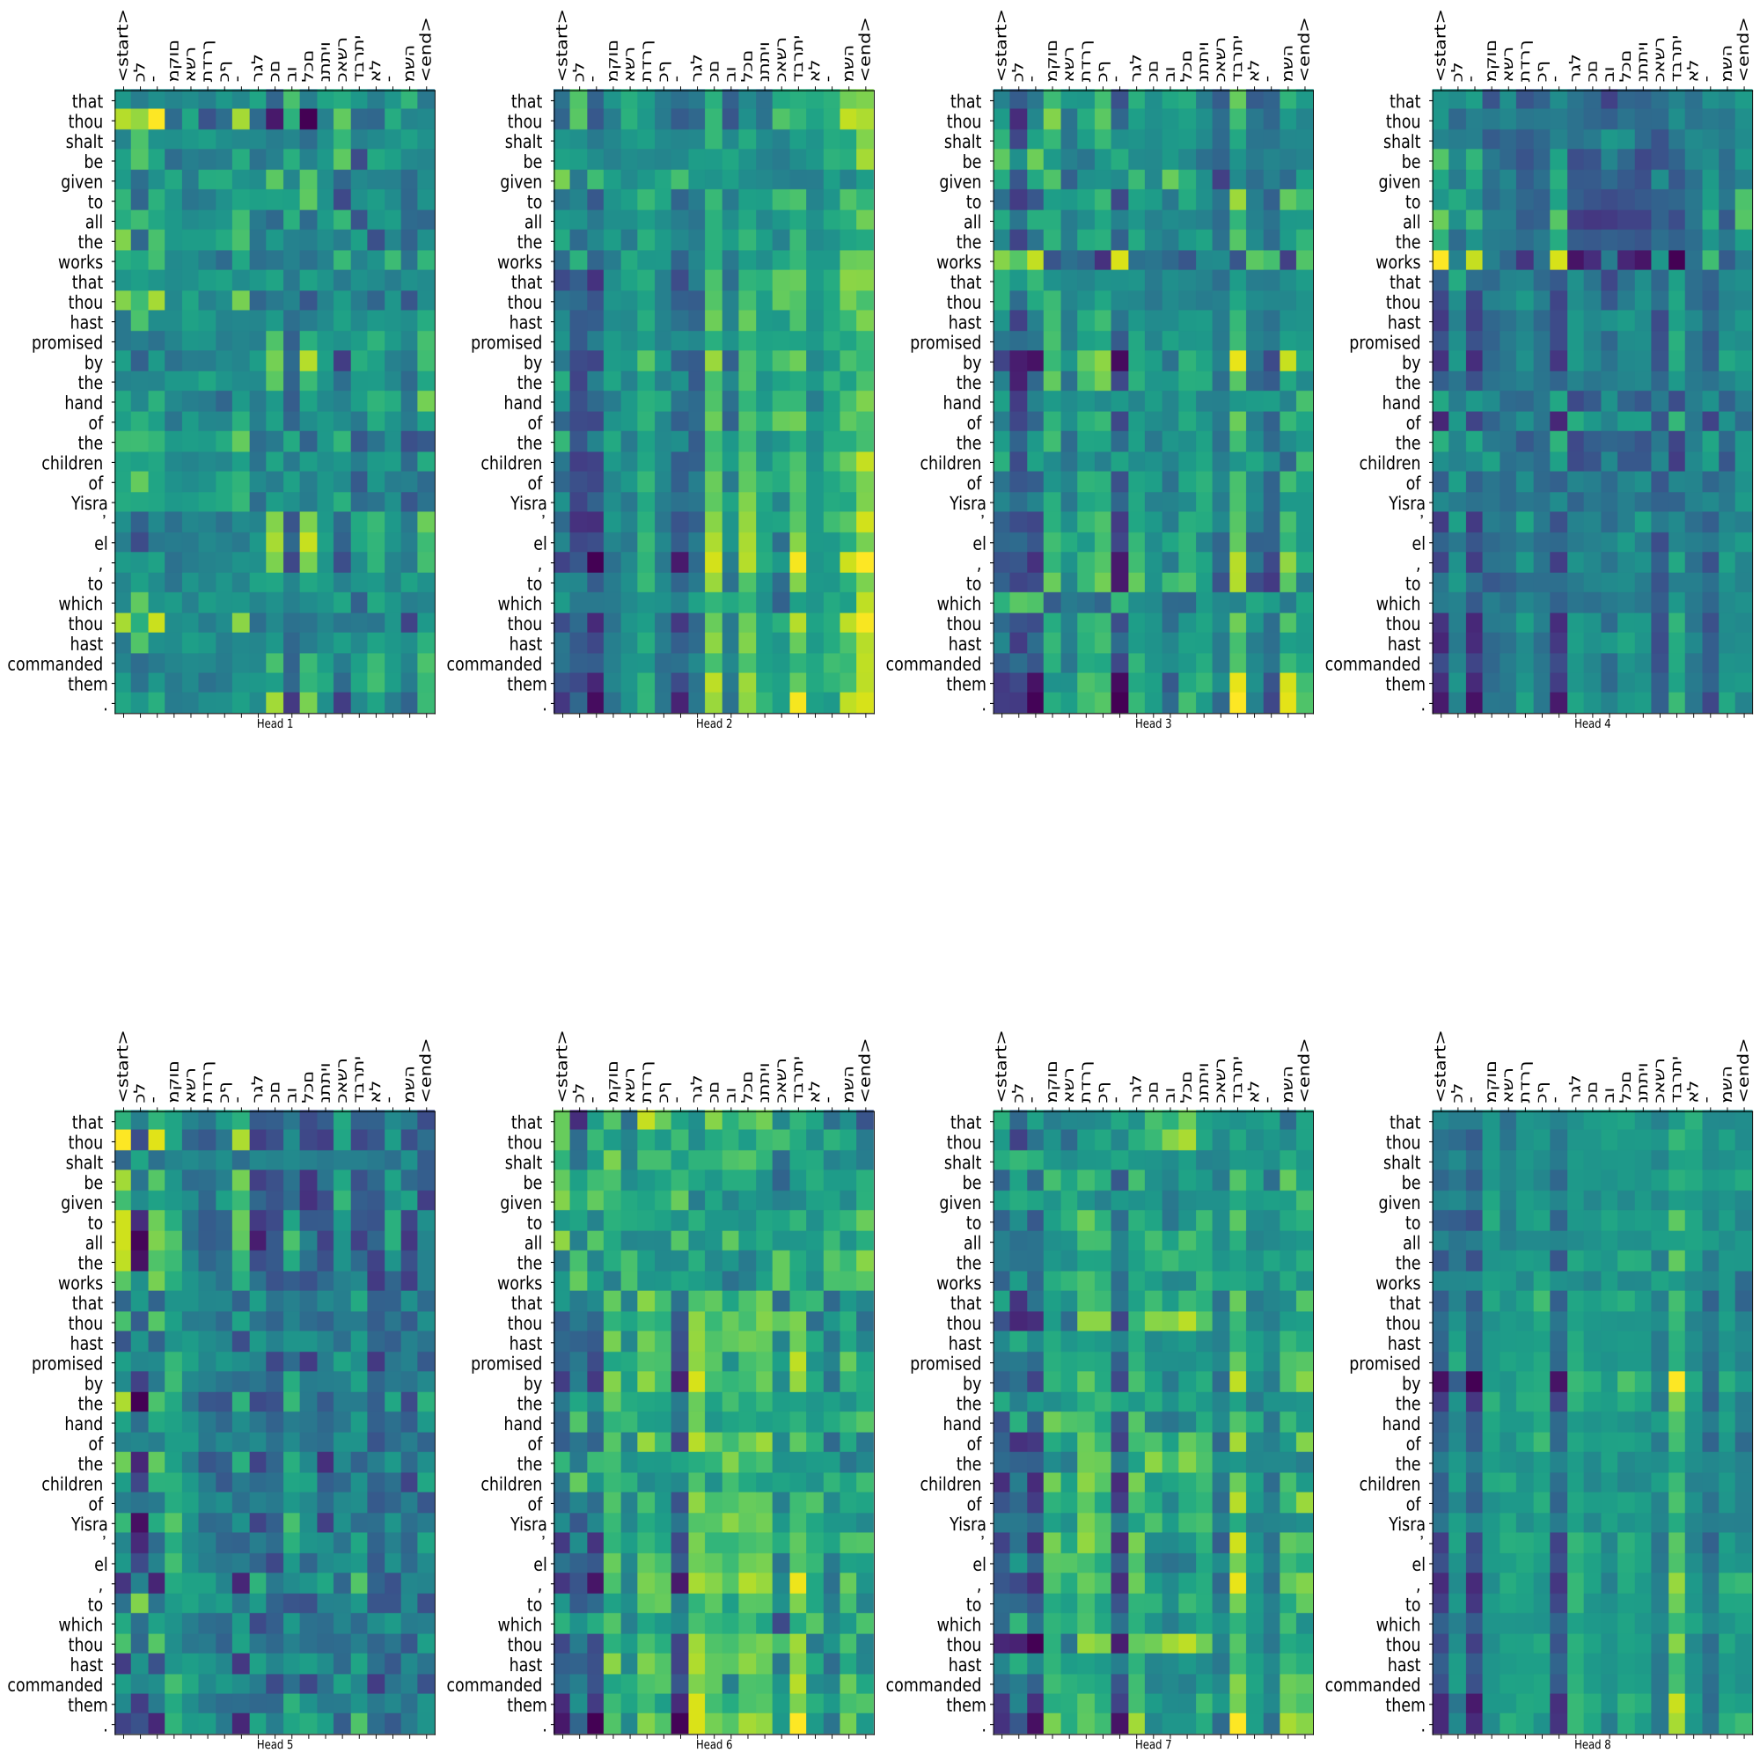
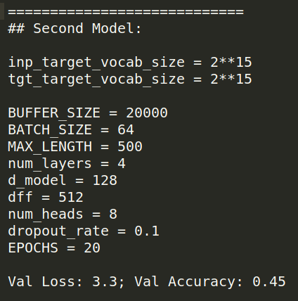
Model Selection

Slide 22
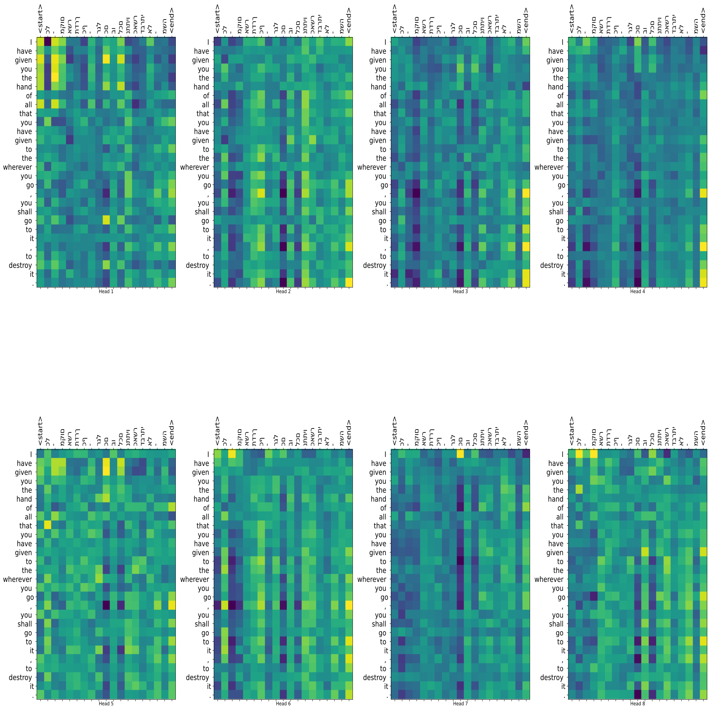
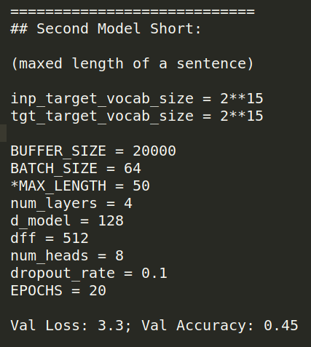
Model Selection

Slide 23
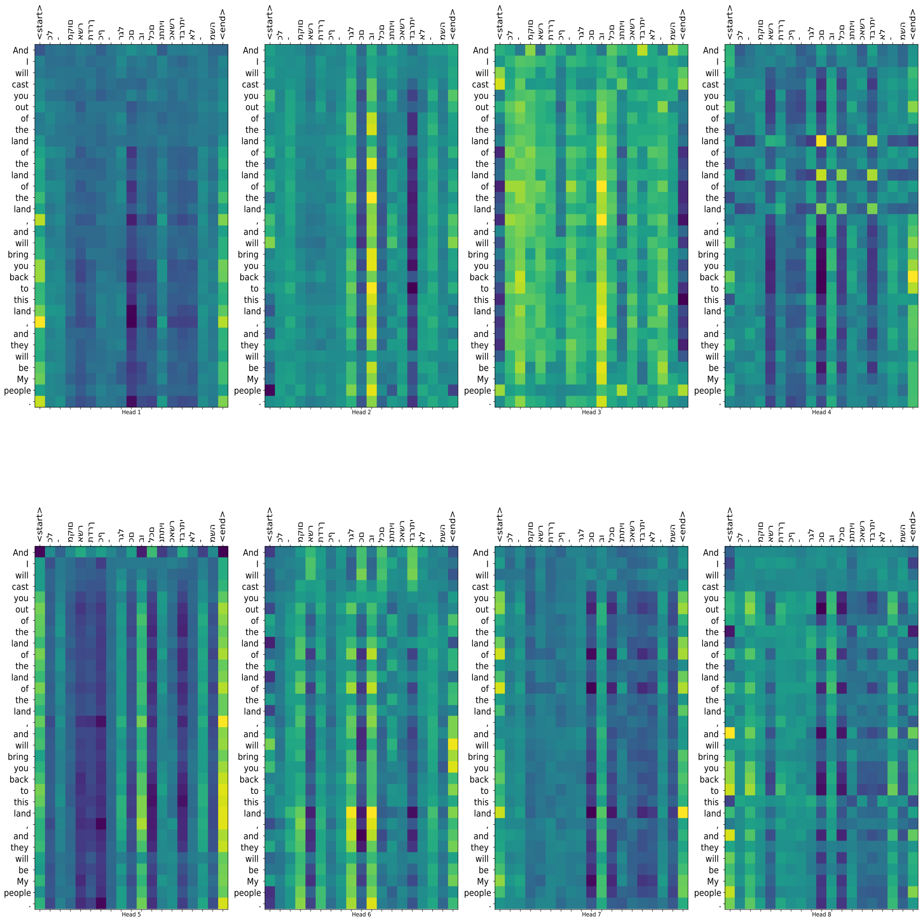
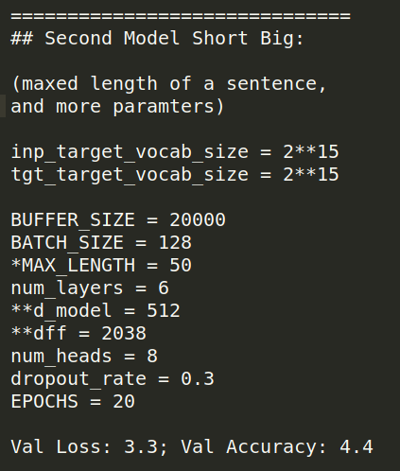
Model Selection

Slide 24
Model STILL bad >=(
Switched from “sub-word” tokenization, to normal word tokenization

Slide 25
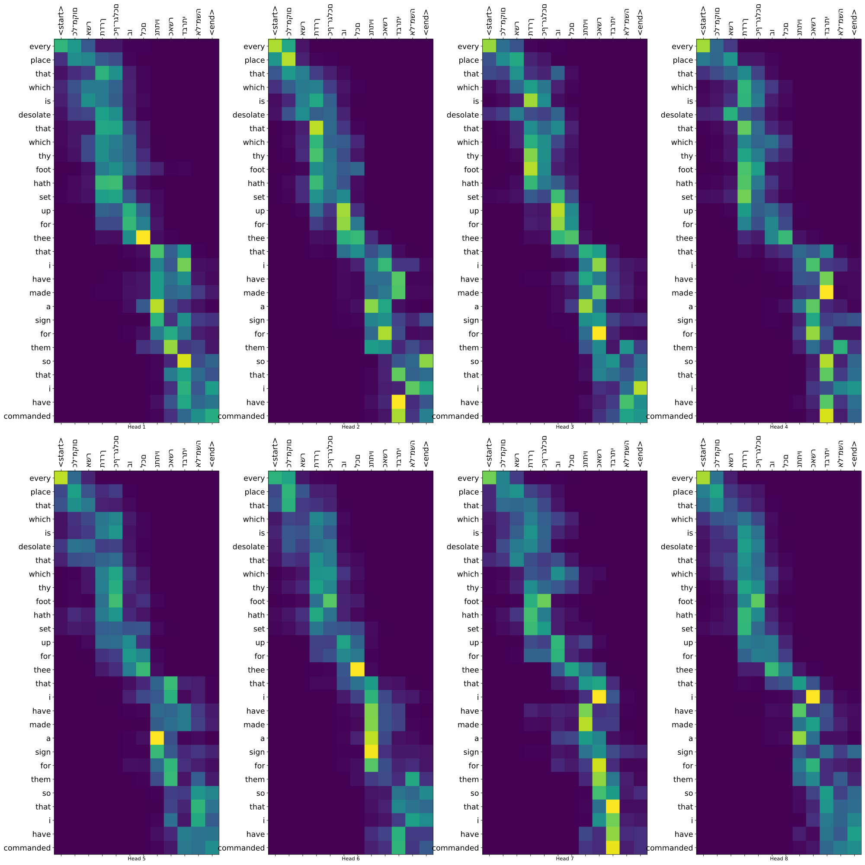
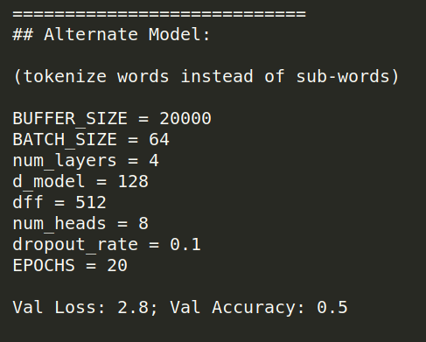
Model Selection

Slide 26
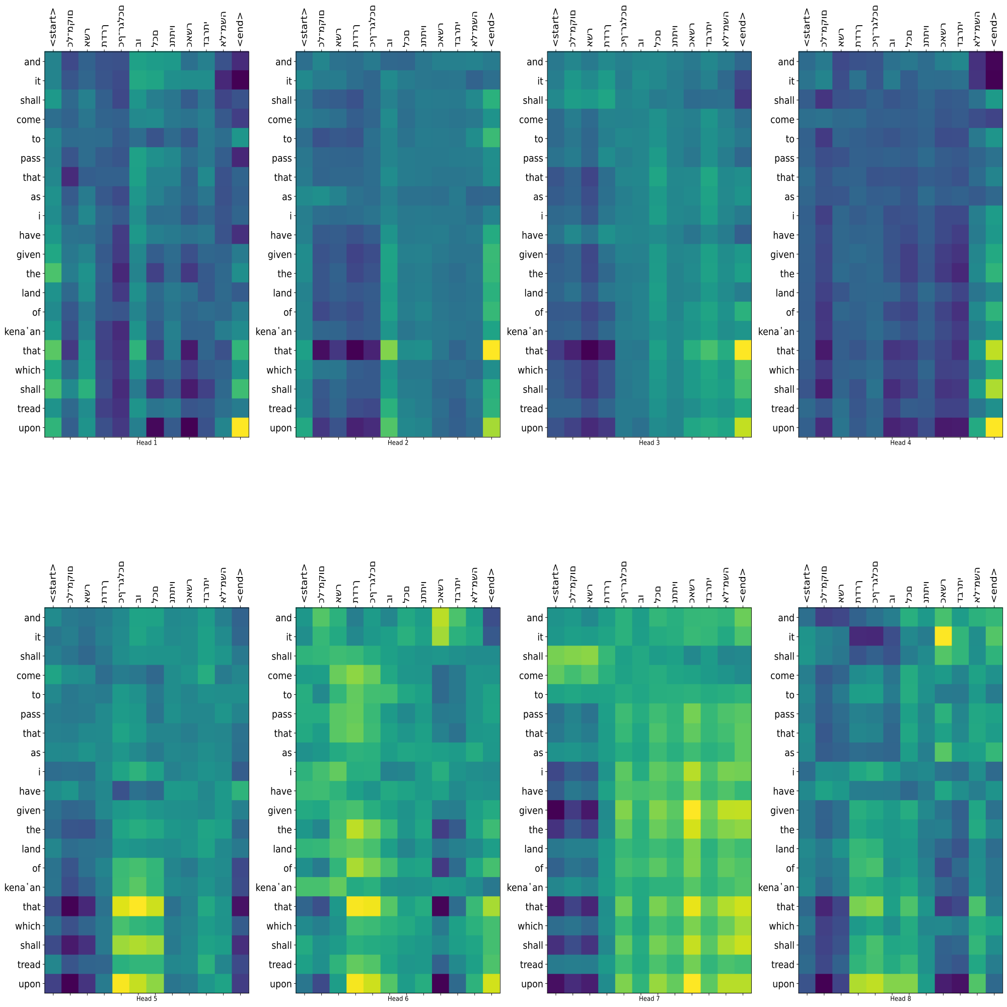
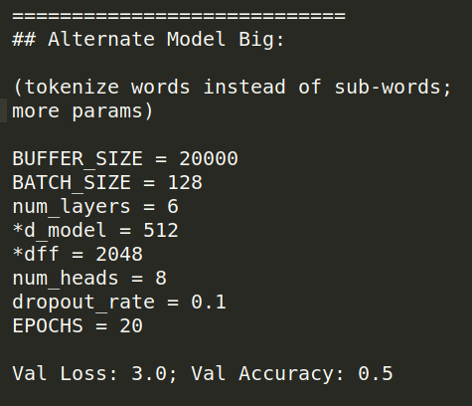
Model Selection

Slide 27
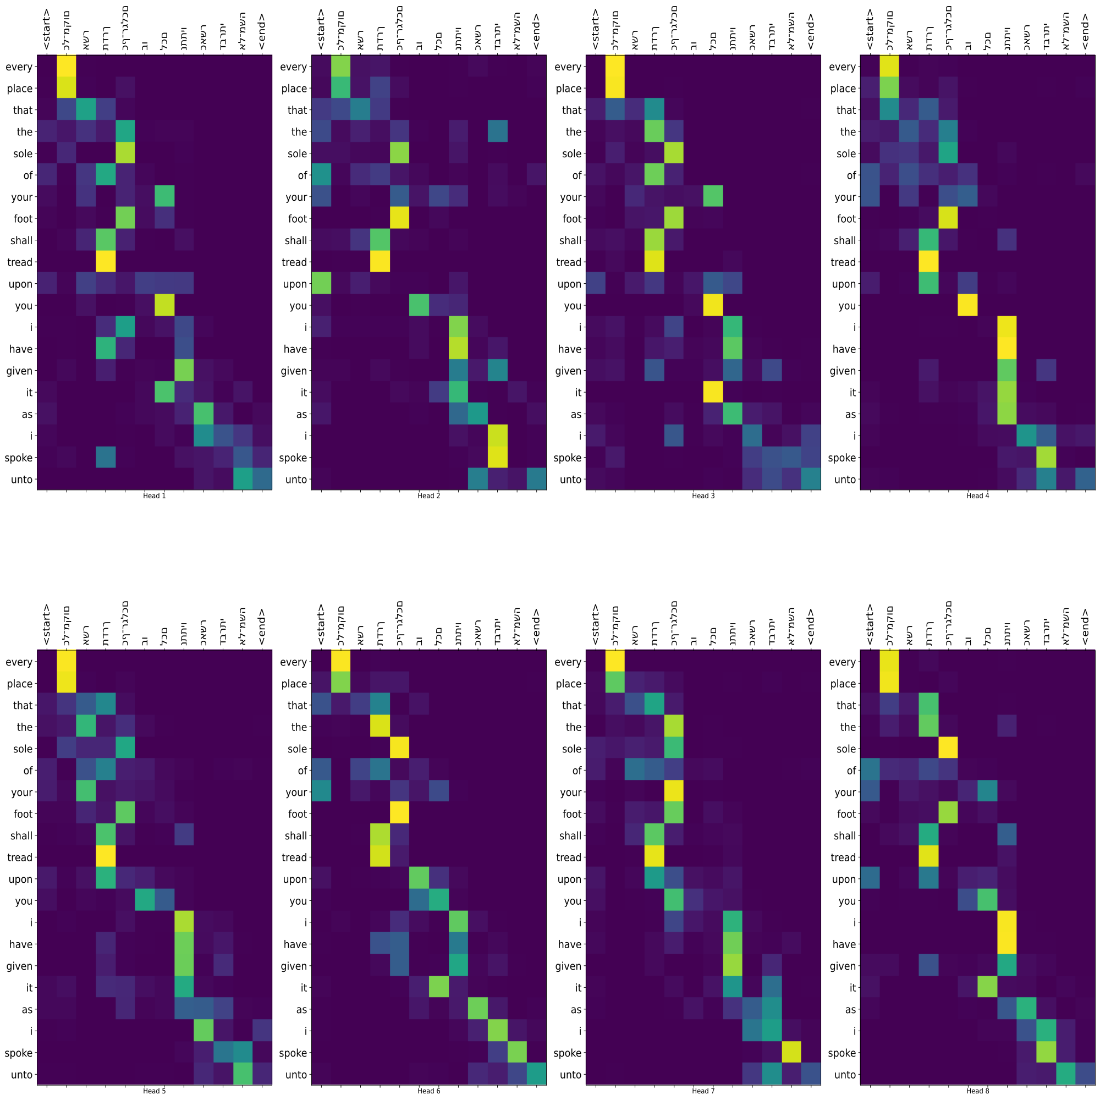
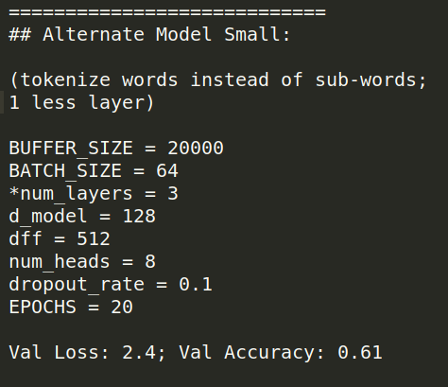
Model Selection

Slide 28
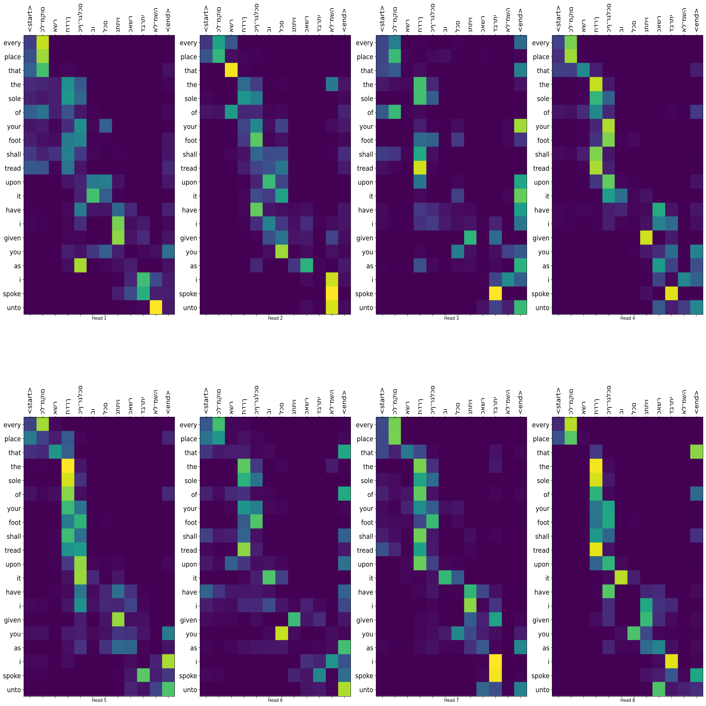
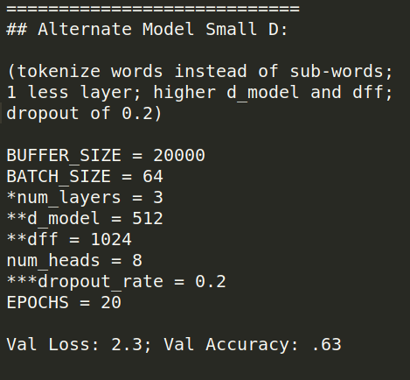
Model Selection

Slide 29
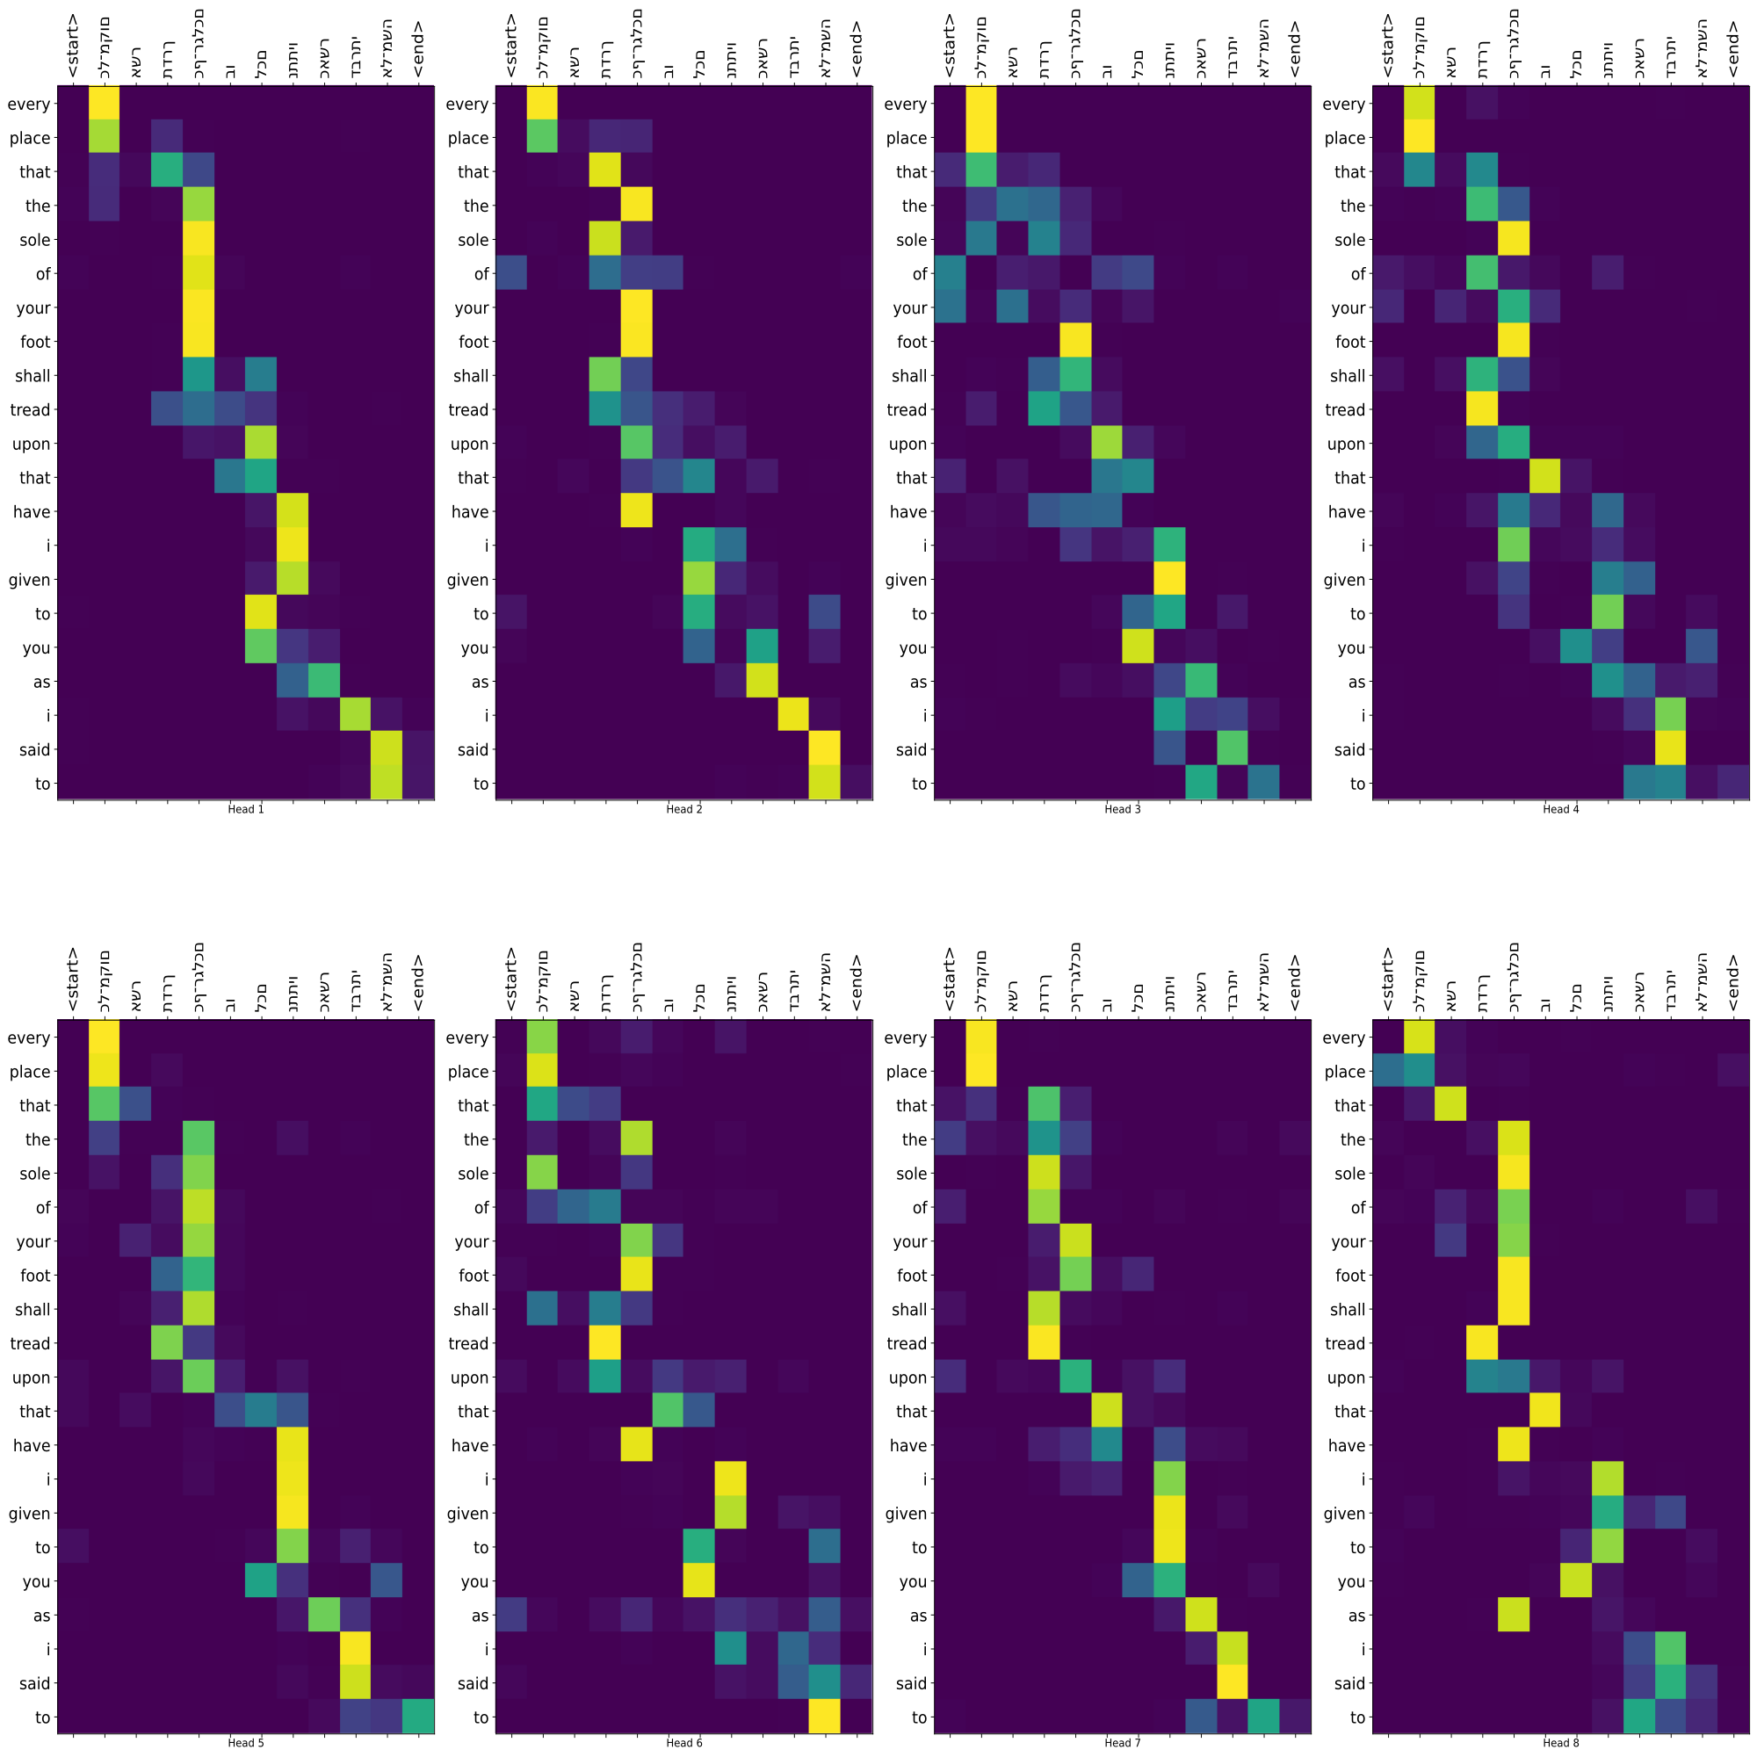
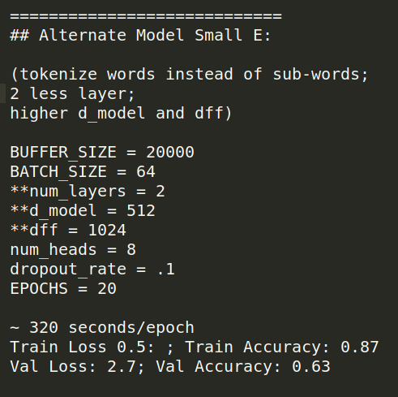
Model Selection

Slide 30
Lets Translate!

Slide 31

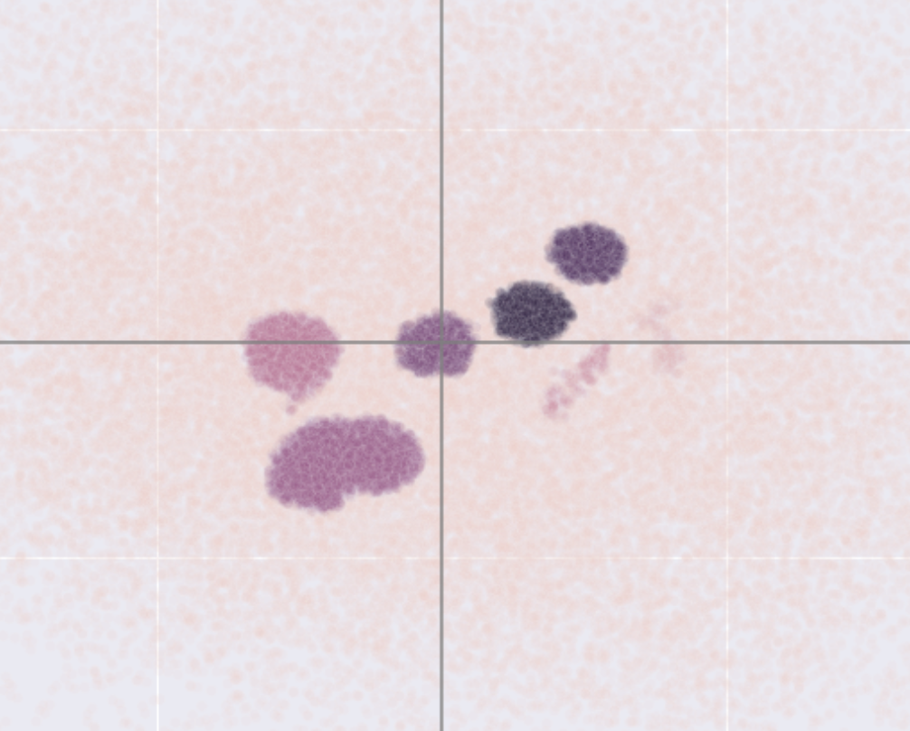
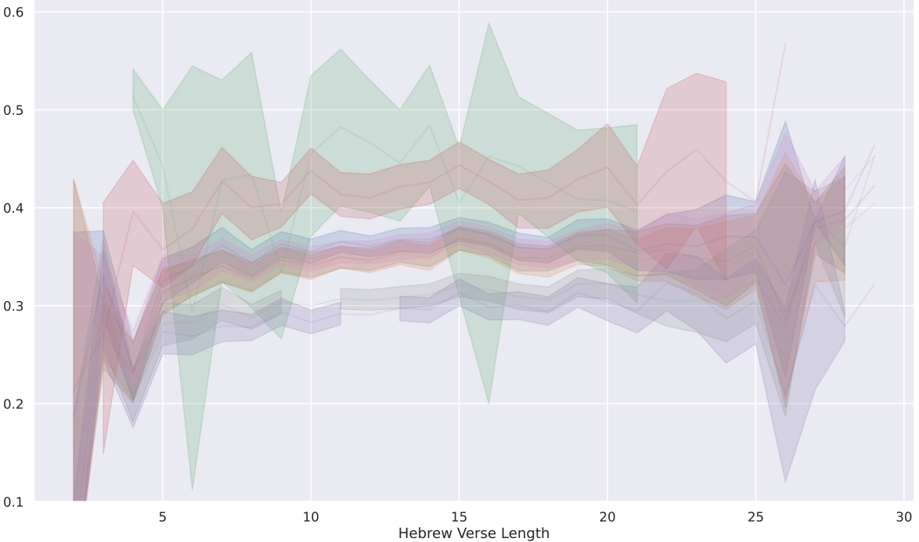
Further Development
(also tune batch size and epochs)
Torah Machine Learning Translation App
Torah Machine Learning Translation App
Select a Verse
Select a Verse
Book
Book
Verse
Book
Book
Verse
Deuteronomy
6
Drop-Down
Deuteronomy
6
4
x
x
x
x
x
or
4
or
5
Enter Hebrew Text…
Enter Hebrew Text…
Shows ML Translation Word Embedding positions, relation to other texts, and model attention heads
6
Translate
Translate
Hebrew
שמע ישראל יהוה אלהינו יהוה אחד
Hebrew
שמע ישראל יהוה אלהינו יהוה אחד
ML Translation
ML Translation
Comprehend Yisrael: TheNAME is your Dieties,
TheNAME is one.
[Neural Net Predicted Text]
JPS
[English Version 1 Text]
Koren
[English Version 2 Text]
Gives NN Translation, and other English Version Translations
Close
Close

Slide 32
Thank You!

